Slide 1

WEB Development
Grade 7&8

Slide 2
Recap of the last Class
Notes:
Objective:
Review the implementation of dropdown menus in a navigation bar using HTML and CSS.
Dropdown Menu: A menu that appears when a user interacts with a navigation item, providing additional links or options.
Reinforce the role of dropdown menus in navigation.
Highlight the HTML structure and CSS required for implementation.

Slide 3
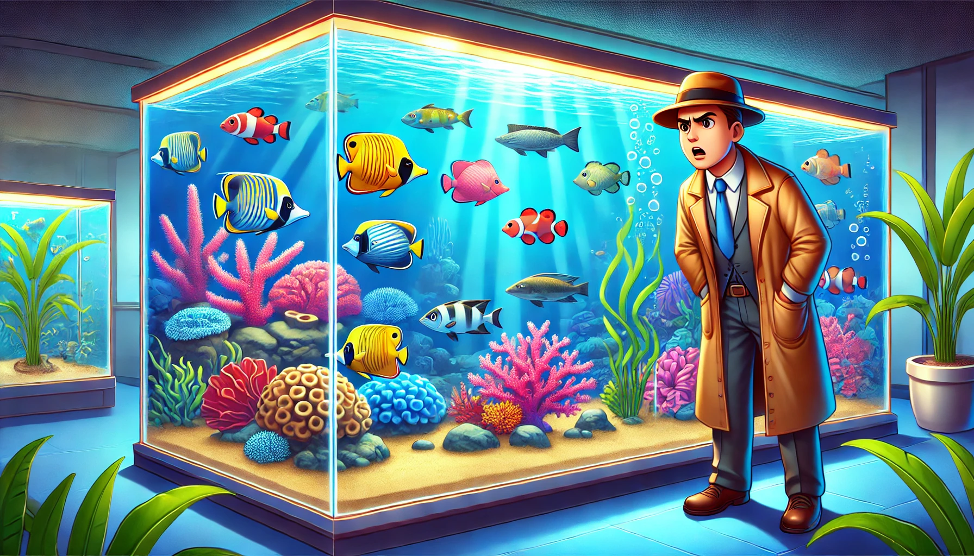
The Restless Fish
"The fish in the aquarium seem restless today, and the zookeeper, Mr. Finn, is puzzled. He notices that different species of fish are behaving strangely in their tanks. Mr. Finn needs your help to solve the riddle and find out why. Here is the riddle:
In the world beneath the sea,
A place of wonder and mystery,
A little change, not seen but felt,
Makes the fish's calmness melt.
What could this change be that affects all the fish? Use your knowledge of marine life and the clues around you to solve the riddle and help Mr. Finn restore peace to the aquarium."
Notes:
Answer:
The answer to the riddle is "water quality."
Fish are highly sensitive to changes in their environment, including pH levels, oxygen content, and cleanliness of the water.
Mr. Finn realizes that maintaining optimal water quality is crucial for the health and behavior of the fish.

Slide 4
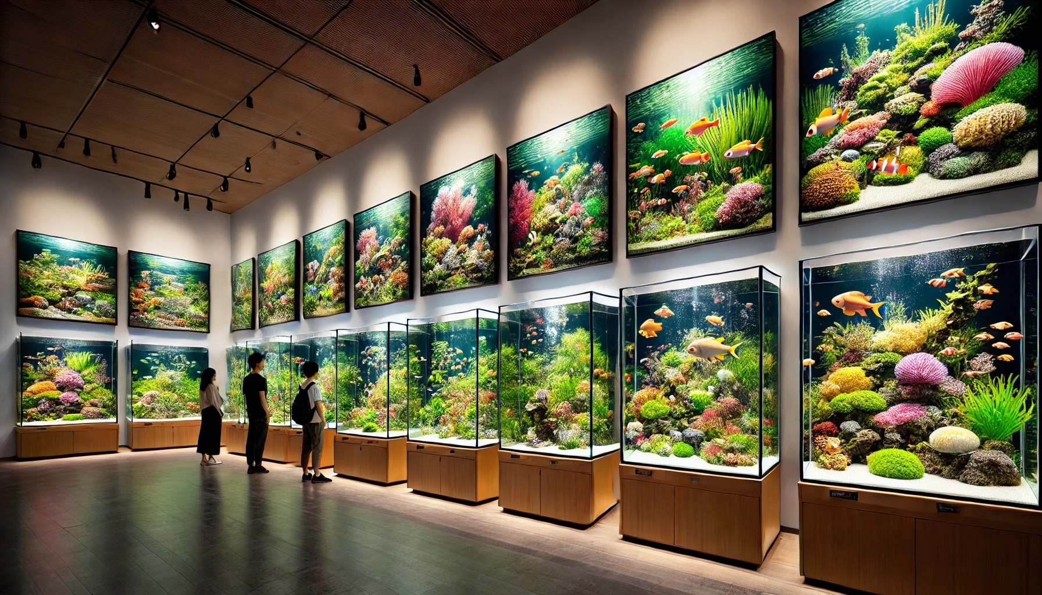
Introduction and Implementation of Images
Notes:
Objective:
Introduce the concept of Images, videos, iframes.
Day 1: Objective
Objective:
Understand the structure and design of a web page, specifically focusing on implementing and styling images.
Learn to create an engaging gallery section with proper HTML and CSS.
Develop skills to observe and interpret the behavior of marine life through an interactive mystery story.

Slide 5
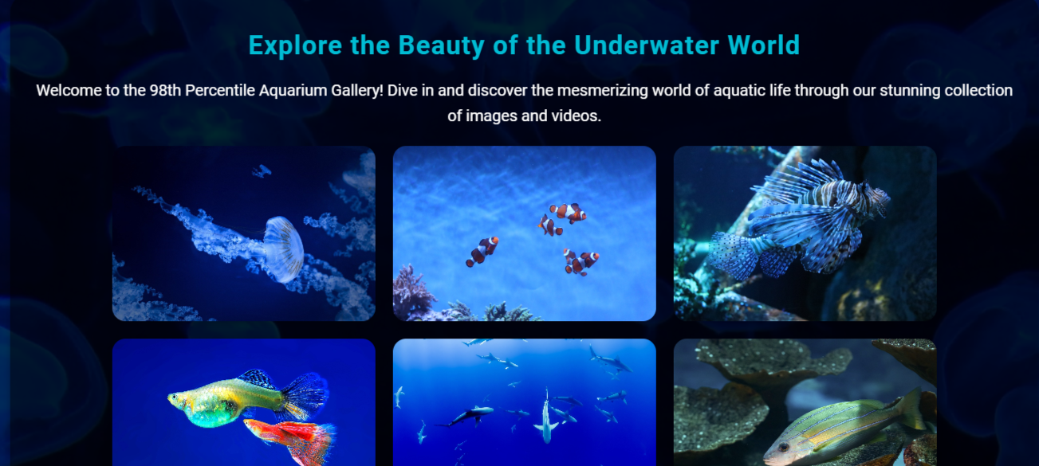
Project – 98th Percentile Aquarium Gallery
Notes:
Project Link: Aquarium Gallery
Objective:
Present the final project example.
Teacher Instructions:
Show the Screenshot:
Display the screenshot of the final project example.
Show the Project in Live Action:
Demonstrate the project on a live website to show how it functions.
Navigate through the website to showcase the images, iframes, videos in background Showcase Animation hover.
Emphasize the importance of marine life and how to protect them.
Explain the Project:
Inform students that they will create a similar project.
Highlight the key features:
A clear and user-friendly Image Gallery.
An engaging webpage using animation.

Slide 6
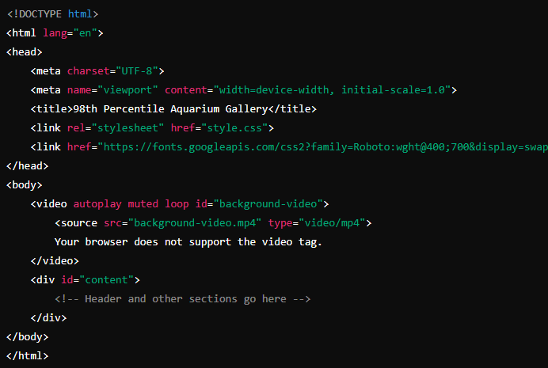
Working with the Project Html Code
Notes:
"Teacher's Activity"
Project Link: Aquarium Gallery
Objective:
Explain the basic structure of an HTML document.
Introduce to Google Font website https://fonts.google.com/
Teacher Instructions:
Display the screenshot of the HTML code.
Provide an overview of the basic structure:
Code Explanation:
<!DOCTYPE html>: Declares the document type and version of HTML.
<html lang="en">: The root element of the HTML document, specifying the language as English.
<head>: Contains metadata and links to resources.
<meta charset="UTF-8">: Sets the character encoding for the document.
<meta name="viewport" content="width=device-width, initial-scale=1.0">: Ensures the page is responsive and displays correctly on different devices.
<title>: Sets the title of the webpage displayed in the browser tab.
<link rel="stylesheet" href="style.css">: Links to the external CSS stylesheet for styling the page.
<link href="https://fonts.googleapis.com/css2?family=Roboto:wght@400;700&display=swap" rel="stylesheet">: Links to the Google Fonts API to use the Roboto font.
<body>: Contains the content of the webpage.
<video autoplay muted loop id="background-video">: Embeds a background video that plays automatically, without sound, and loops continuously.
<source src="background-video.mp4" type="video/mp4">: Specifies the source of the video.
<div id="content">: Wrapper for the main content of the page.

Slide 7
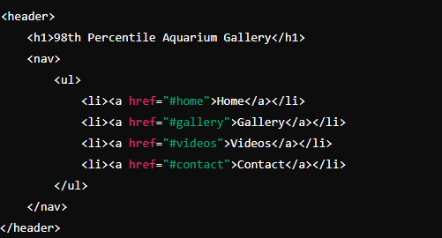
Working with the Project
Header and Navigation
Notes:
"Teacher's Activity"
Project Link: Aquarium Gallery
Objective:
Explain the basic structure of an HTML document.
Teacher Instructions:
Display the screenshot of the HTML code.
Provide an overview of the Header section and Navigation section.
Code Explanation:
<header>: Defines the header section of the webpage.
<h1>: Main heading displaying the title "98th Percentile Aquarium Gallery."
<nav>: Navigation section containing links to different parts of the webpage.
<ul>: Unordered list used for the navigation items.
<li>: List item representing each navigation link.
<a>: Anchor tag for the navigation links, using href to link to specific sections.

Slide 8
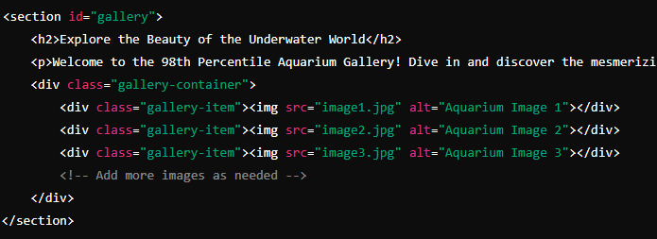
Working with the Project
Gallery Section with Images
Notes:
"Teacher's Activity"
Project Link: Aquarium Gallery
Objective:
Explain the basic structure of an HTML document.
Teacher Instructions:
Display the screenshot of the HTML code.
Provide an overview of the Gallery Image Section.
Code Explanation:
<section>: Defines a section of the webpage with the id "gallery."
<h2>: Subheading for the gallery section.
<p>: Paragraph describing the gallery.
<div class="gallery-container">: Container for the gallery items.
<div class="gallery-item">: Each gallery item containing an image.
<img>: Image tag with src for the image file and alt for alternative text.

Slide 9
Html Structure Done
Let's Style it Now
Notes:
Objective:
Review the code till now
Project Link: Aquarium Gallery
Teacher Instructions:
Recap the key points.
Encourage interactive discussion and exploration of html code.

Slide 10
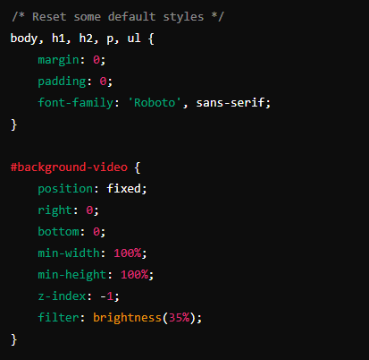
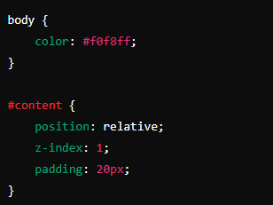
Working with the Project
CSS Code Explanation:
Styling background video and modifying z-index of content :
Notes:
Objective:
Project Link: Aquarium Gallery
Teacher Instructions:
Display the screenshot of the CSS code.
Explain the styling for the body:
body, h1, h2, p, ul: Reset default margin and padding for these elements and set the font family.
#background-video: Style for the background video, making it fixed and full screen with a brightness filter.
body: Set the text color for the body.
#content: Style the main content area with relative positioning and padding.

Slide 11
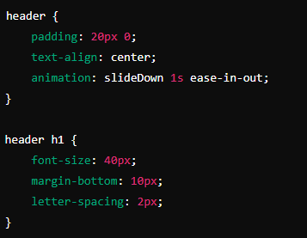
Working with the Project
CSS Code Explanation:
Styling header and header title :
Notes:
Objective:
Project Link: Aquarium Gallery
Teacher Instructions:
Display the screenshot of the CSS code.
Explain the styling for the header:
header: Style for the header with padding, center alignment, and a slide-down animation.
header h1: Style the main heading with font size, margin, and letter spacing.

Slide 12
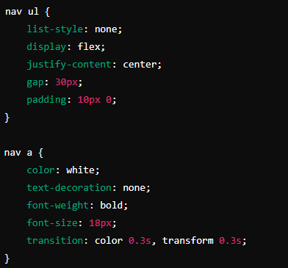
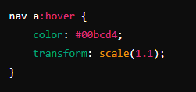
Working with the Project
CSS Code Explanation:
Styling Nav and responsive to Hover :
Notes:
Objective:
Project Link: Aquarium Gallery
Teacher Instructions:
Display the screenshot of the CSS code.
Explain the styling for the Nav:
nav ul: Style the unordered list in the navigation bar to remove bullets, display items in a row, center them, and add spacing.
nav a: Style the navigation links with color, no underline, bold text, font size, and a transition effect.
nav a:hover: Add hover effect to change color and scale up the link.

Slide 13
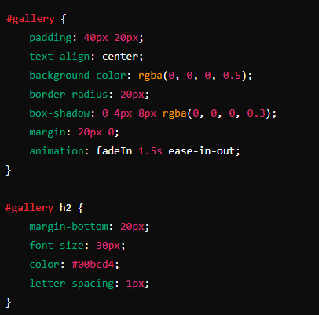
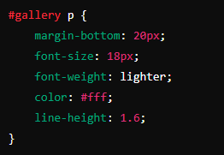
Working with the Project
CSS Code Explanation:
Styling gallery section :
Notes:
Objective:
Project Link: Aquarium Gallery
Teacher Instructions:
Display the screenshot of the CSS code.
Explain the styling for the gallery section:
#gallery: Style the gallery section with padding, center alignment, background color, border radius, shadow, margin, and fade-in animation.
#gallery h2: Style the subheading with margin, font size, color, and letter spacing.
#gallery p: Style the paragraph with margin, font size, lighter weight, color, and line height.

Slide 14
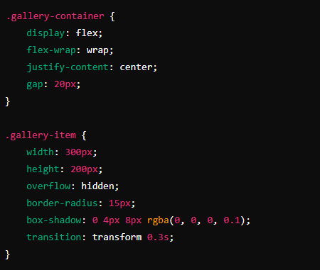
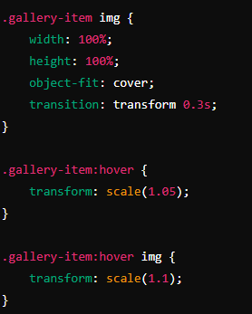
Working with the Project
CSS Code Explanation:
Styling gallery container :
Notes:
Objective:
Project Link: Aquarium Gallery
Teacher Instructions:
Display the screenshot of the CSS code.
Explain the styling for the gallery container:
.gallery-container: Style the container to use flexbox for layout, wrapping items, centering them, and adding spacing.
.gallery-item: Style each gallery item with width, height, hidden overflow, border radius, shadow, and transition effect.
.gallery-item img: Style the images to cover the entire gallery item, with transition effect.
.gallery-item:hover: Add hover effect to scale up the gallery item.
.gallery-item:hover img: Add hover effect to scale up the image inside the gallery item.

Slide 15
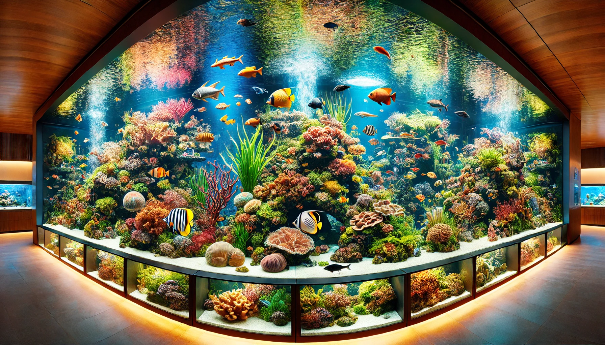
Now it's your turn!
Task:
Add More Images to the Gallery:
Find additional images of underwater scenes or fish from Google.
Save the images to your local project folder.
Update the HTML:
Add the new images to the gallery section in your HTML file.
Instructions: Share the code with others and work as a group to give your own personalization to the final web page.
Notes:
"Students' Activity"
Objective:
Allow students to use their creativity in designing the aquarium gallery page
Teacher Instructions:
Guide the students on how to search for appropriate images on Google.
Show them how to save the images to their project folder.
Demonstrate how to update the HTML to include the new images.
Ensure students understand the importance of maintaining consistent styling for a cohesive look.
For images use website like pixabay or unsplash

Slide 16

How to Save & Share the project.
Replit offers autosave option – so not worry about the same.
To share project with someone in view mode: just copy the link from the URL bar, and share the link
To share the project for collaboration
Click on "Invite" from the top right corner
If you know the username, type it in the box and click on invite
You can also turn on the toggle button "private join link" to create a public collaboration link and invite members to edit your code.
Notes:
Instructions for the Teacher:
Explain how to save and share projects on Replit, including the options for collaboration.
Emphasize the importance of sharing projects for feedback and collaboration.

Slide 17

What HTML element is used to create a container for images in the gallery?
a) <section>
b) <div>
c) <img>
d) <span>
Notes:
b) <div>

Slide 18
What attribute in the <img> tag specifies the path to the image file?
a) src
b) alt
c) href
d) title
Notes:
Answer: a) src

Slide 19
What CSS property is used to control the spacing between items in a flex container?
a) margin
b) padding
c) gap
d) border
Notes:
Answer: c) gap

Slide 20
Which CSS property is used to change the size of an element on hover?
a) background-color
b) transform
c) display
d) font-size
Notes:
Answer: b) transform

Slide 21

Introduction to Web Page Structure:
DOCTYPE, HTML, Head, and Body elements.
Importance of metadata and external resources.
Header and Navigation:
Creating a header with a title and navigation links.
Gallery Section:
Implementing images using the <div> and <img> tags.
Structuring and styling the gallery with CSS.
CSS Styling:
Resetting default styles.
Styling header, navigation, and gallery sections.
Using Flexbox for layout and adding hover effects.
What have we learnt?
Notes:
Objective:
Summarize the key learnings from the lesson.
Teacher Instructions:
Instruct Student's to recap Today's Learning
Keep a healthy discussion engage student to a group discussion
Show a glimpse of what is awaiting to be reveal on the next class

Slide 22

Homework Discussion
Notes:
Instructions for the Teacher: Facilitate a discussion about the homework assignment.

Slide 23

Be Skeptical of Promises
If something online sounds too good to be true, like 'free games for life,' it could be a trick.
Oliver saw an ad online promising "free games for life" and eagerly clicked on it, hoping for a great deal.
Instead, his computer got infected with malware, causing a lot of problems.
The moral of the story: don't believe ads or emails promising free stuff without checking with an adult first, as it could be a trick.

